Slide 1

Varendra University
Dept. of Computer Science & Engineering (CSE)
Microprocessor, Microcontroller
Course Title: Microprocessor and Assembly Language
Course No: CSE 3205
Prepared By:
Md. Adnan Sami
Lecturer, Dept. of CSE, VU

Slide 2
Outline
Microprocessor.
Microcontroller.
Difference between microprocessor and microcontroller.

Slide 3
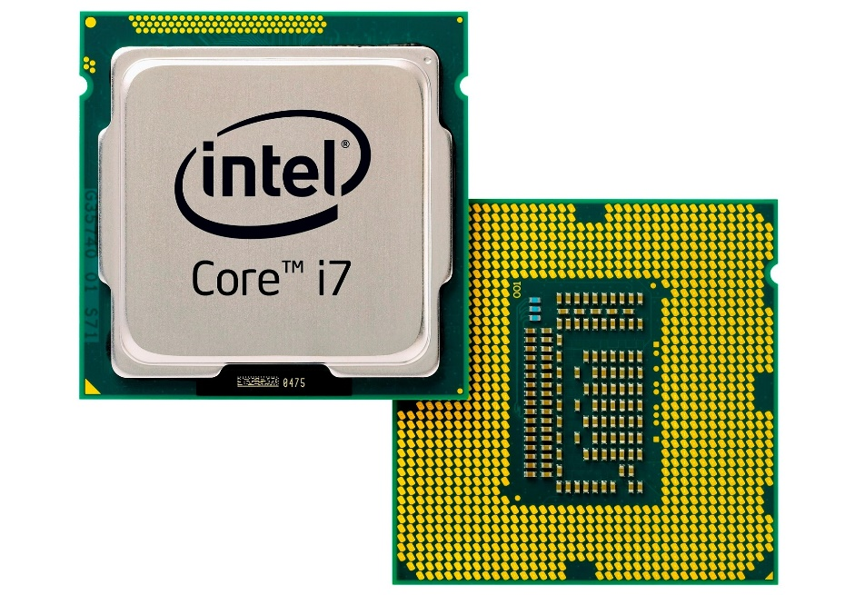
Microprocessor
Microprocessor is a processor which incorporates the functions of a CPU on a single integrated circuit (IC).
Types of microprocessor:
8086
8085
8088
Application of microprocessor:
Personal computer.
Mobile device.

Slide 4
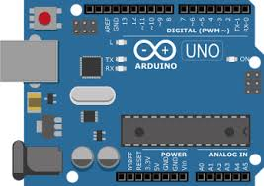
Microcontroller
Microcontroller is a compact integrated circuit designed to govern a specific operation in an embedded system.
Embedded systems are focused on controlling and monitoring specific functions within a device.
Application of microcontroller:
Washing Machine.
Fire detection and safety device.

Slide 5
Difference between microprocessor and microcontroller
Microprocessor | Microcontroller
It is used for big application. | It is used to execute a single task.
It is the heart of computer system. | It is the heart of the embedded system.
It is just a processor. Memory and I/O components have to be connected externally. | It contains external processor along with internal memory and I/O components.
Power consumption is high. | Power consumption is low.
Cost is more. | Cost is less.
Difficult to replace. | Easy to replace.
Application: Personal computer. | Application: Washing machine.

